Slide 1
Simplified and Fair Credit Risk Assessment
ANKURAM
Akshay Jambhulkar
Amrutha C.
Gajendra Muley
Muskan Rath
Neha Thakur
Nency Badiyani
Tanuja Tanushree

Slide 2
Develop a fair, unbiased, and explainable model to identify the probability of credit card customers defaulting on their obligations.

Slide 3
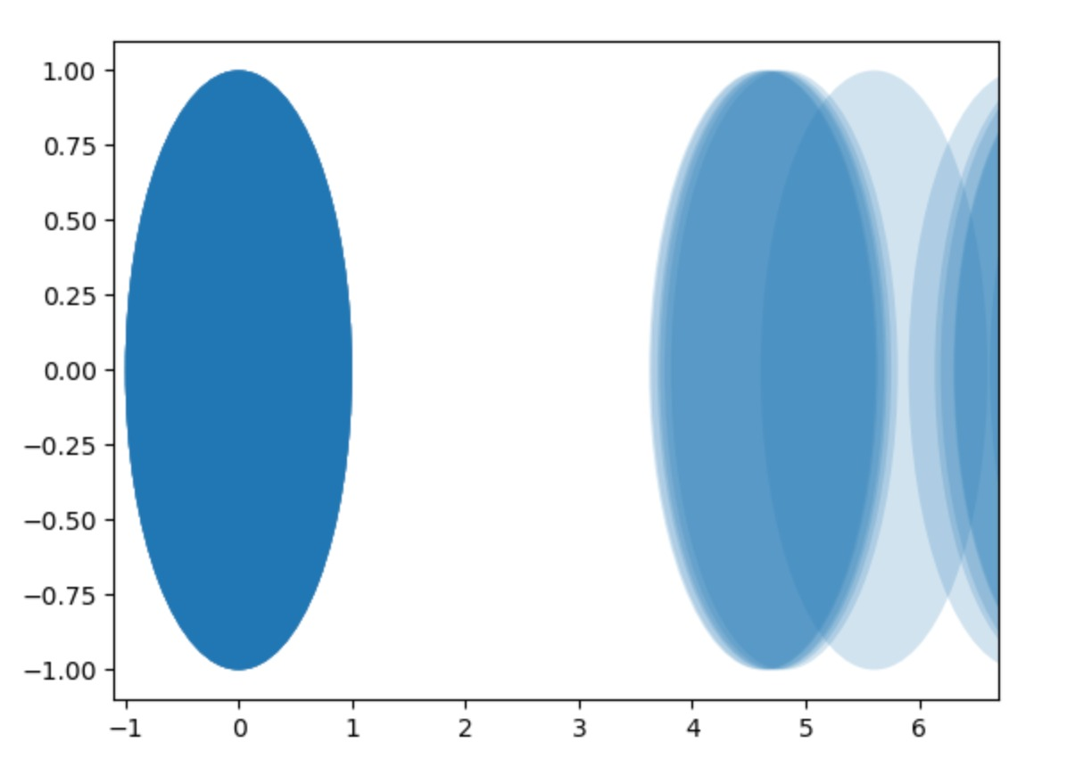
“Like striking gold in the data mines, a rare and precious discovery.”
No null values.
No proxy features – Cosine Similarity.
Protected Features – sex, age, marriage, and education.

Slide 4
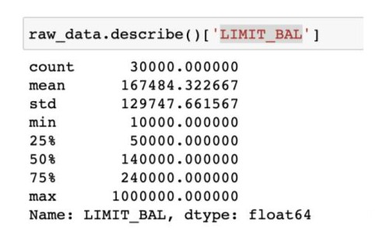
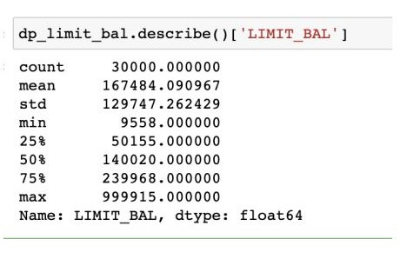
Enough noise to protect privacy, enough signal to draw insights.
Applied Differential Privacy on limit balance.
Setting Epsilon to 0.5 results a reasonable level of privacy protection.
The impact on the overall description of the data is relatively small.

Slide 5
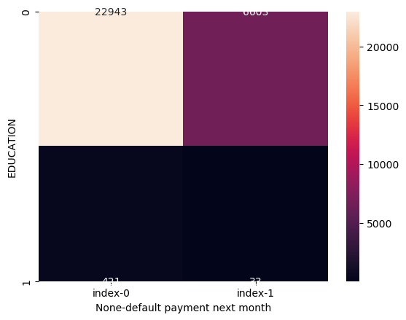

Finding Bias In Feature Classes
22943
6603
23315
6631
421
33
49
05
People who have not graduated high school are unprivileged.
Unmarried people are unprivileged.
Combine Education and Marriage_0 to form a composite feature

Slide 6
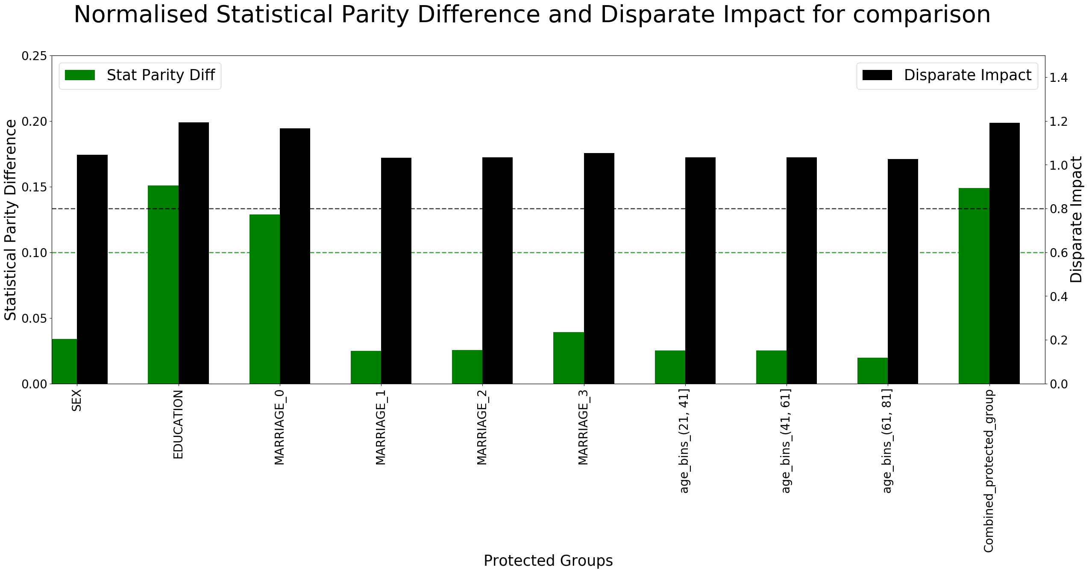
Finding Bias In Feature Classes
SPD suggests that Education and Marital Status have bias among the classes.
If the algorithm says that 10 educated people will not default, it should also predict ‘not default’ for at least 9 uneducated people.

Slide 7
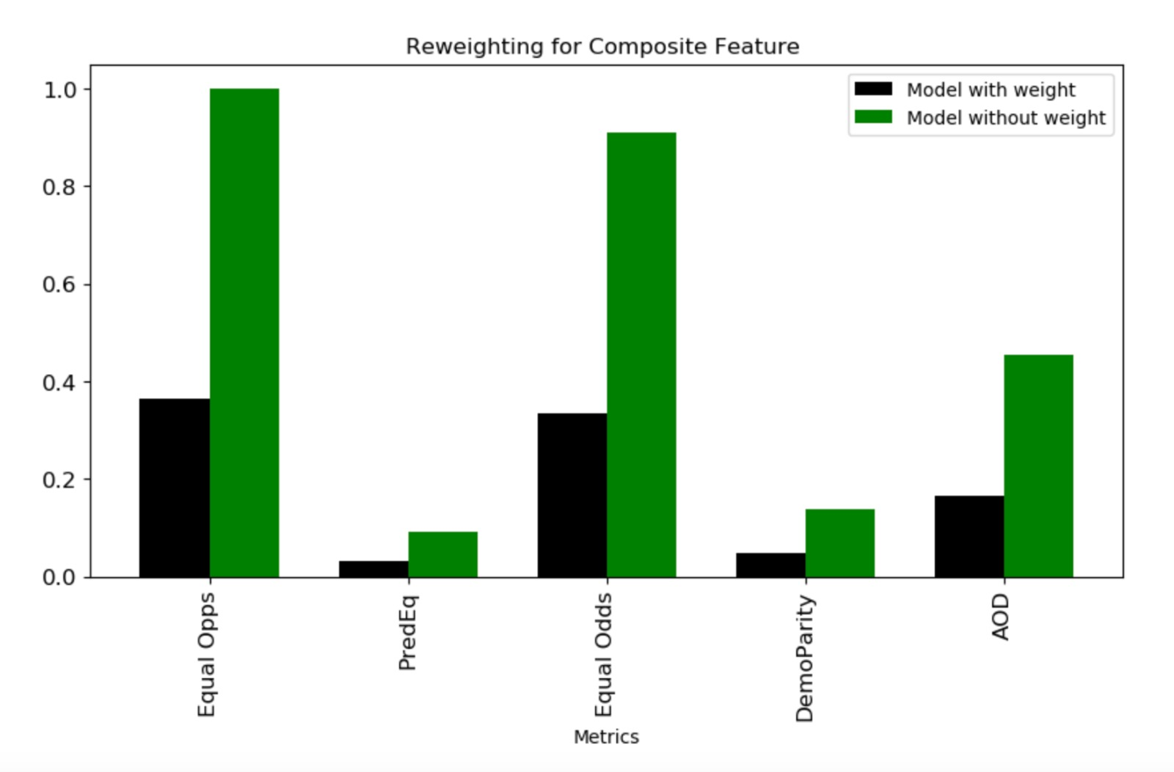

Zero Discrimination
Remove bias by reweighing.

Slide 8
Divide data in 4 parts
RAW DATA
WITHOUT DP
WITH DP
WEIGHTED
NOT WEIGHTED
WEIGHTED
NOT WEIGHTED
Train these datasets on Random Forest and ADA Boost

Slide 9
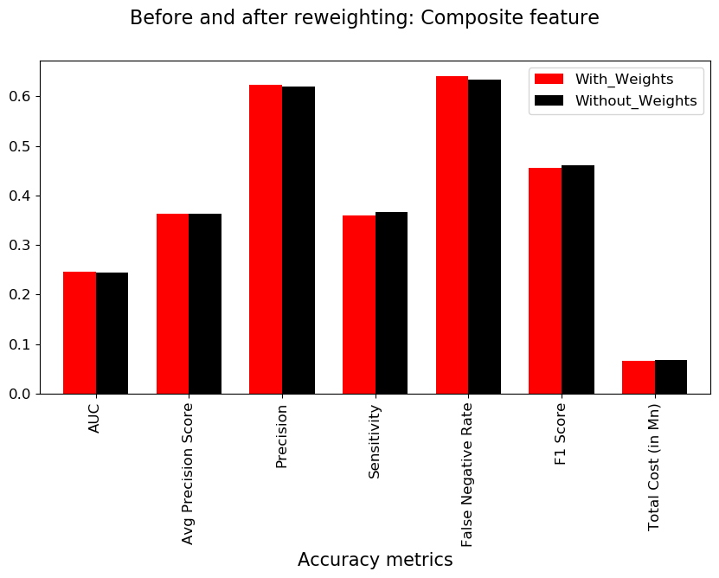
Random Forest
Weighted dataset with differential Privacy
No significant difference in accuracy metrics.

Slide 10
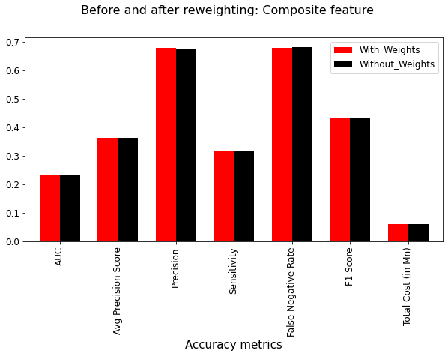
ADA Boost
Weighted dataset with differential Privacy
No significant difference in accuracy metrics.

Slide 11
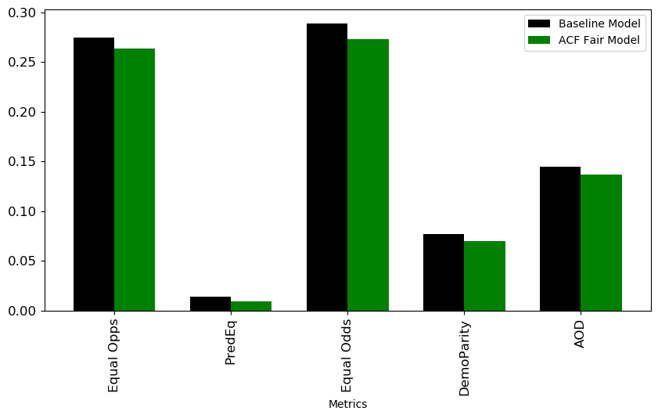
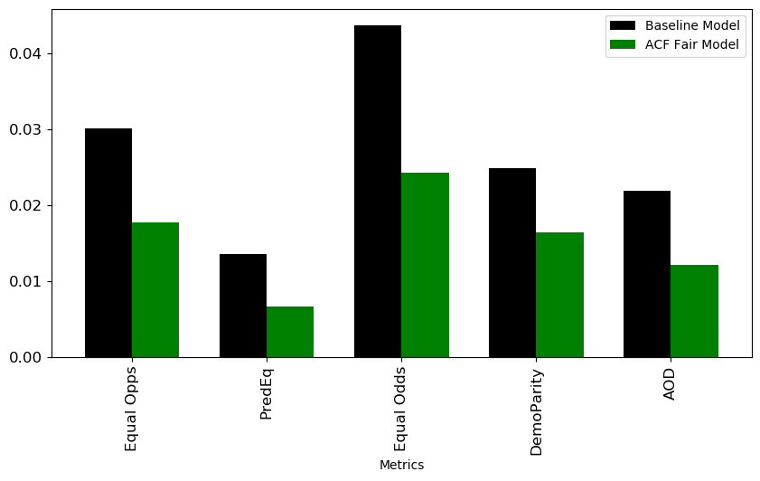
Remove Bias with ACF – Random Forest
Raw data
Significant improvement in Fairness based on Education.
Marriage
Education

Slide 12
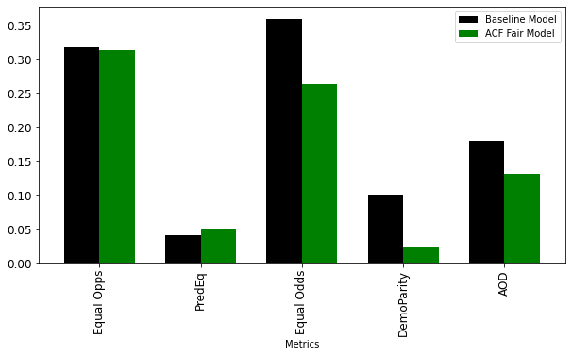
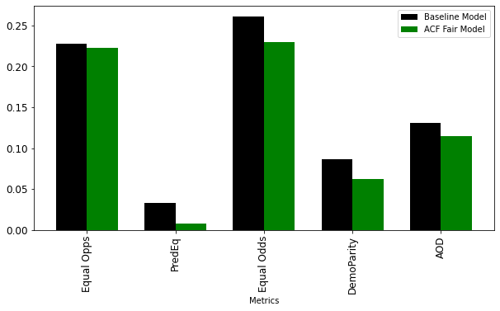
Remove Bias with ACF – ADA Boost
Raw data
Significant improvement in Fairness based on Marriage.
Marriage
Education

Slide 13
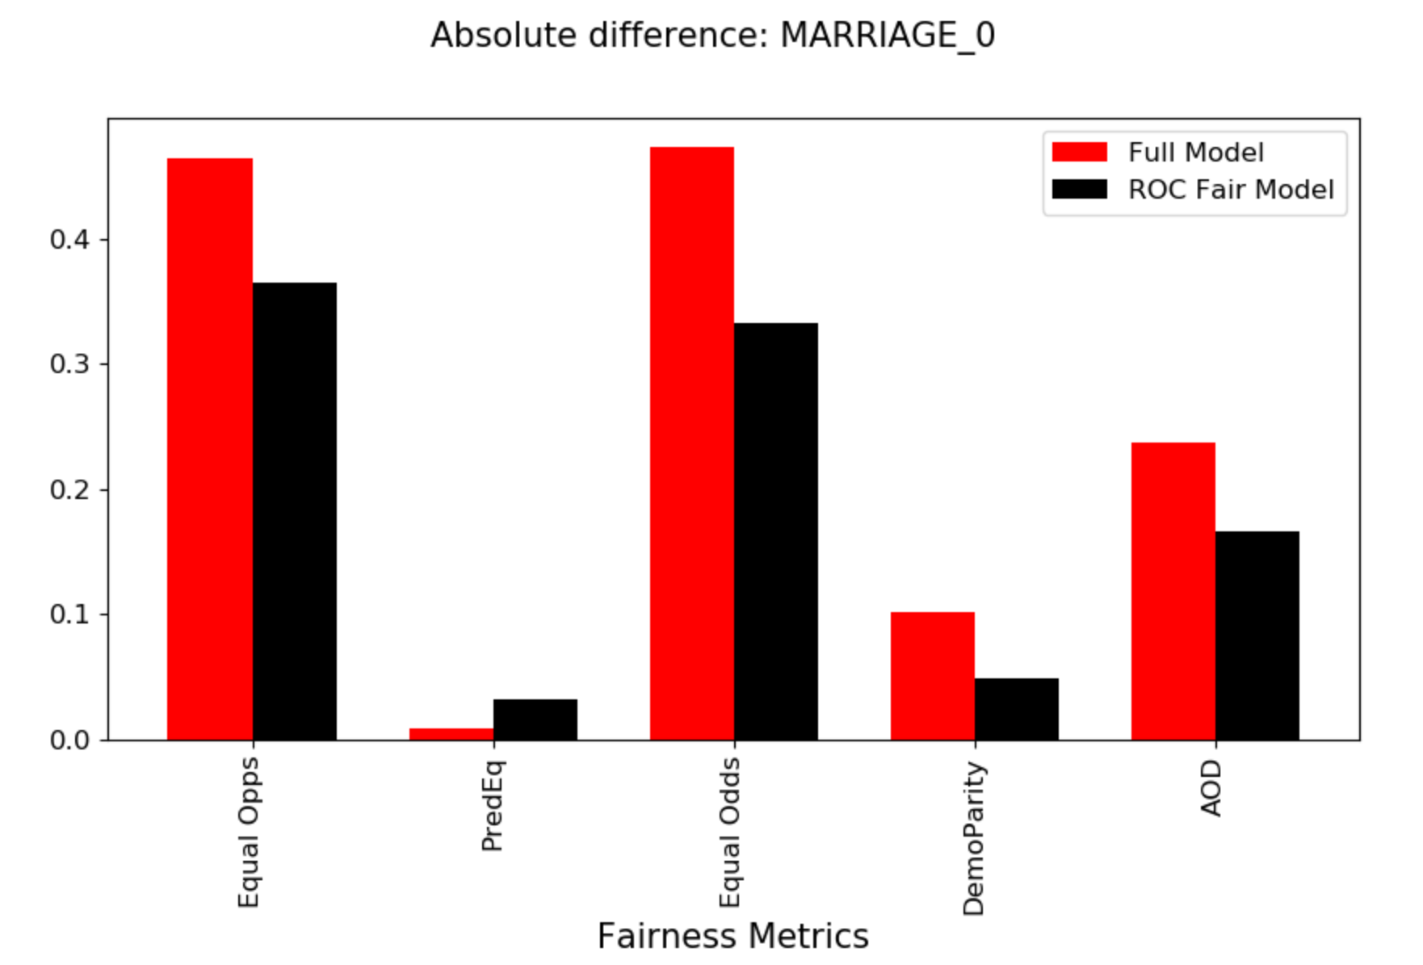
ROC Random Forest
10% improvement in equal opportunity.
14% improvement in equal odds.
07% improvement in AOD.

Slide 14
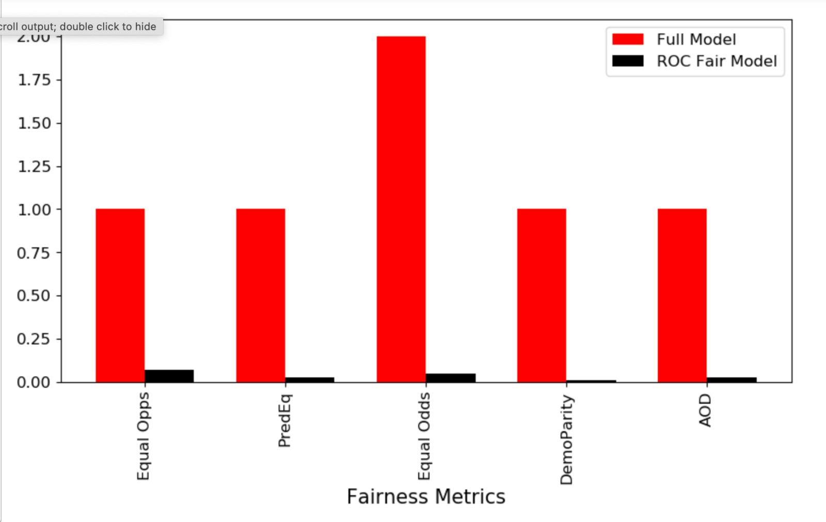
ROC ADA Boost
93% improvement in equal opportunity.
98% improvement in demographic parity.
97% improvement in AOD.

Slide 15
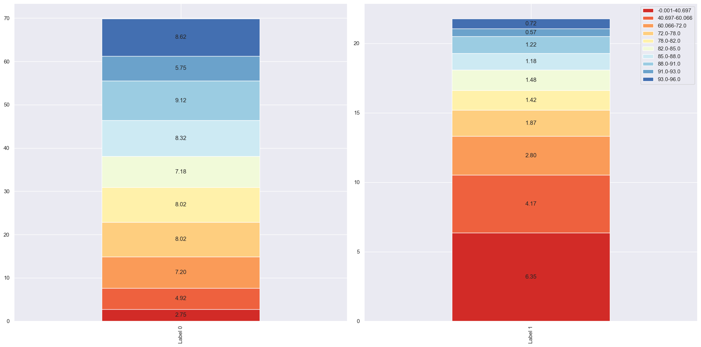
Explainability Using Split Quantile Graph of Probabilities

Slide 16
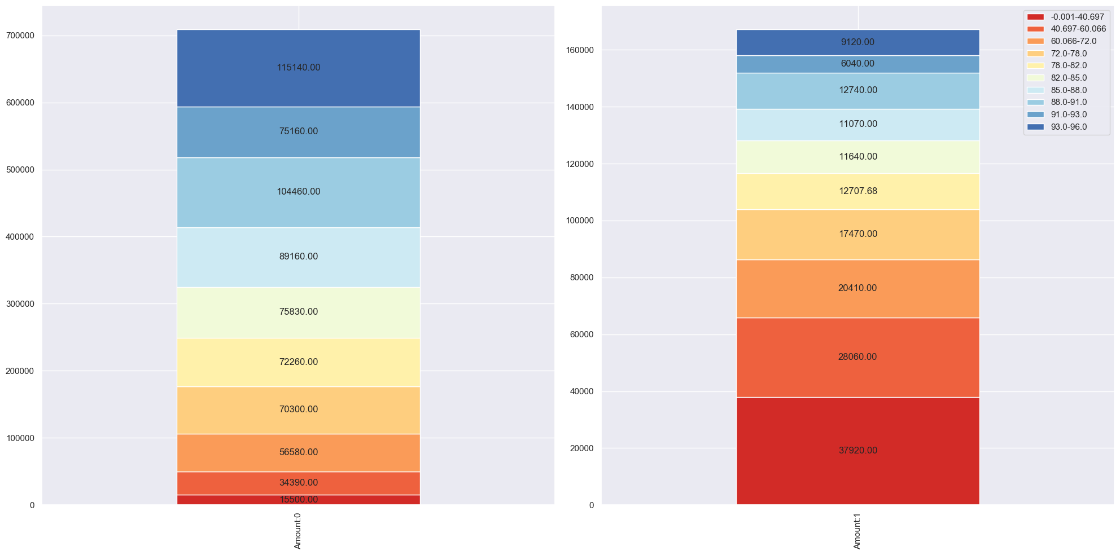
Explainability Using Split Quantile Graph of Amount

Slide 17
Thank You!

